Slide 1
ESB Business School
at Reutlingen University
ESB Business School
Reutlingen University

Slide 2
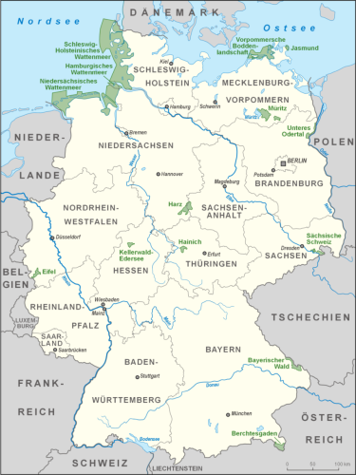
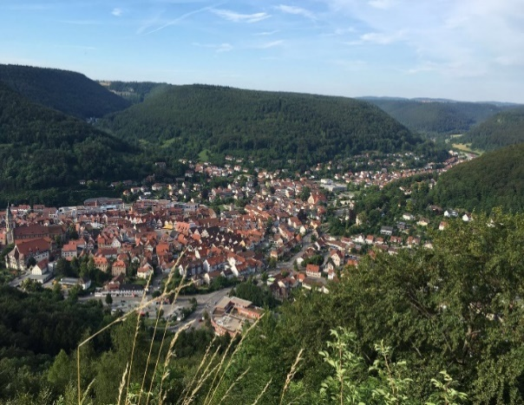
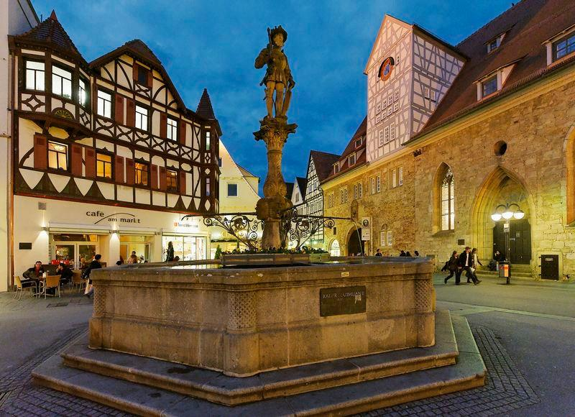
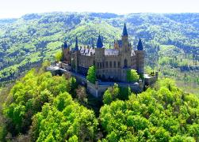
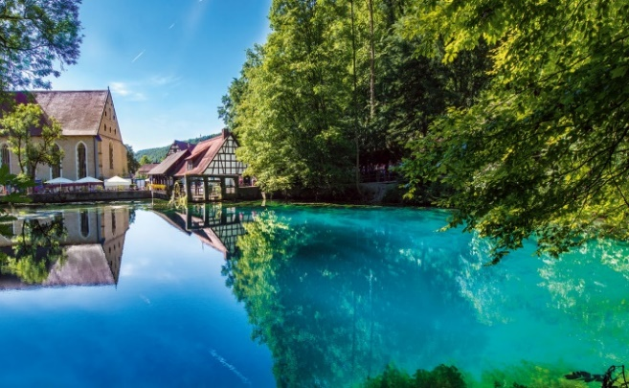
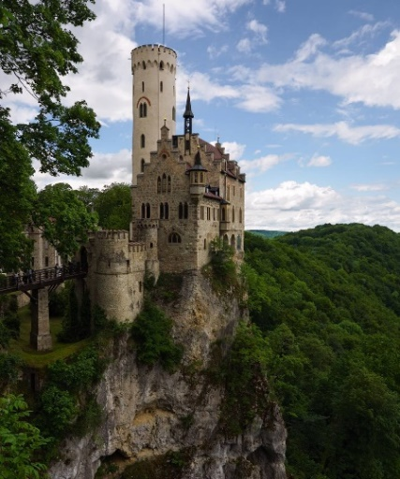
Location
Reutlingen – located just in the of Europe
Reutlingen is located approx. 30km south of Stuttgart, the capital city of Baden-Wuerttemberg – nestled just beneath the Swabian mountains and near the famous Black Forrest.

Slide 3
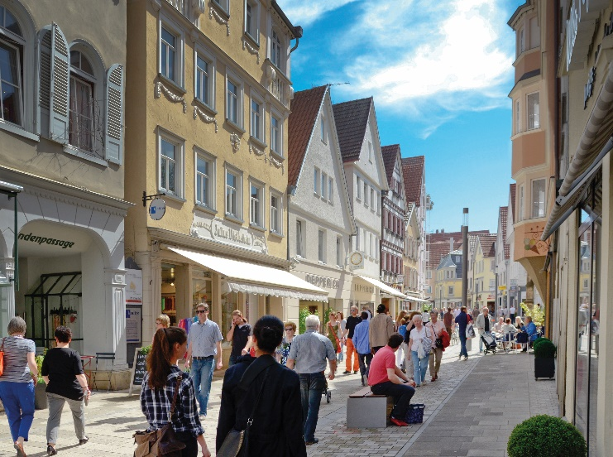
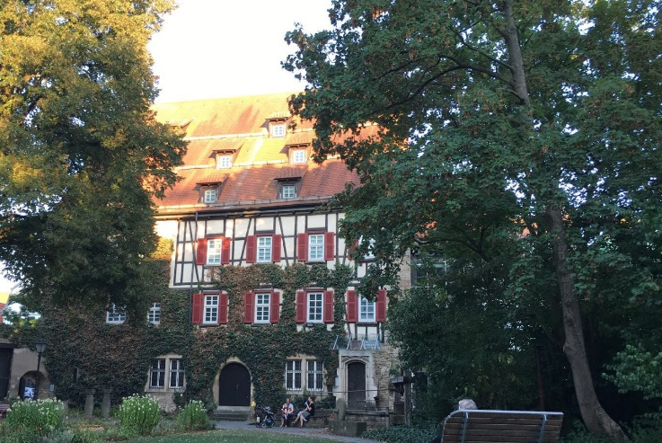
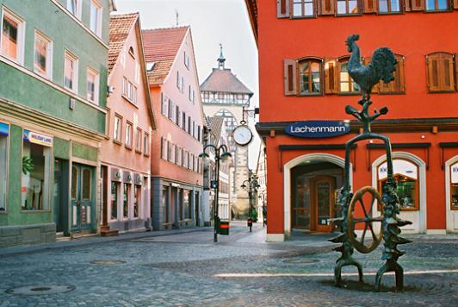
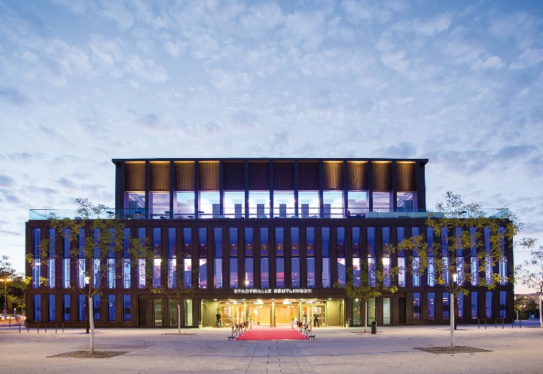
Studying in reutlingen
Reutlingen -
Gateway to the Swabian Alb

Slide 4
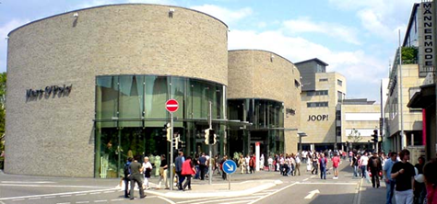
City of Reutlingen
Reutlingen and its surroundings
Reutlingen has some 115.000 inhabitants and is considered to be the safest city in Germany.
Reutlingen offers a wide range of shops, markets, cultural and leisure facilities, all of which combine to make it a young city with a modern atmosphere.
The region is home to the world or European headquarters of many well-known companies including Hugo Boss, Daimler, Porsche, Bonduelle Bosch, Celesio, Hewlett-Packard and IBM.

Slide 5
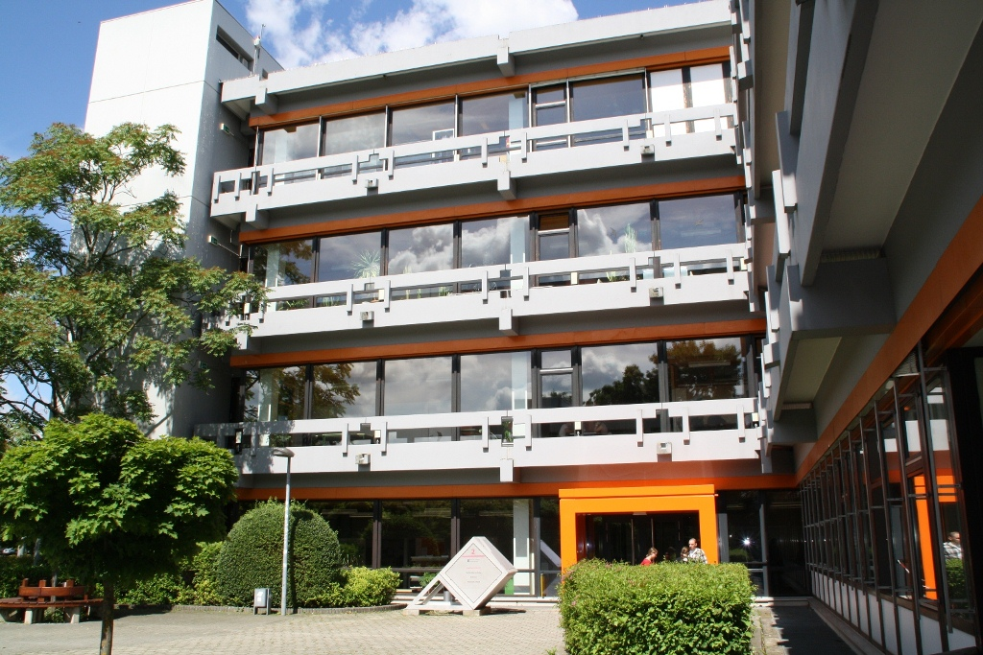
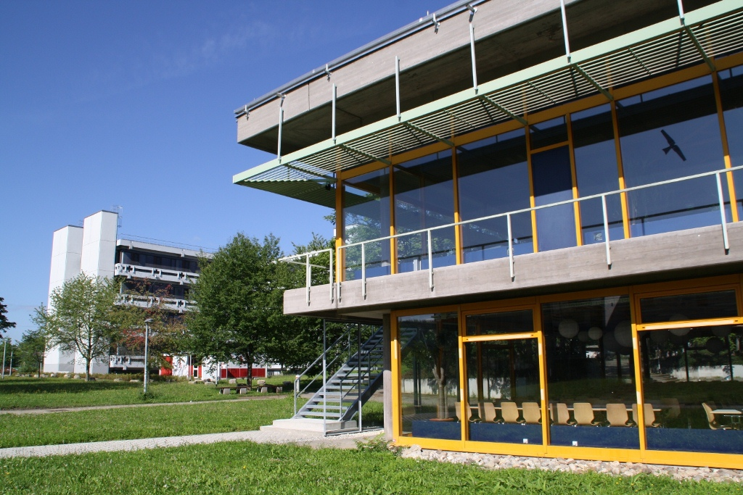
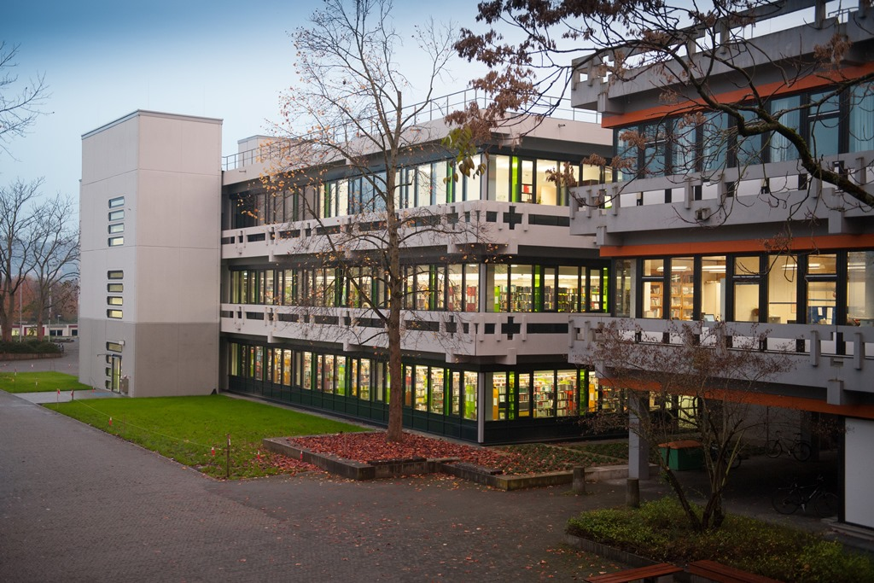
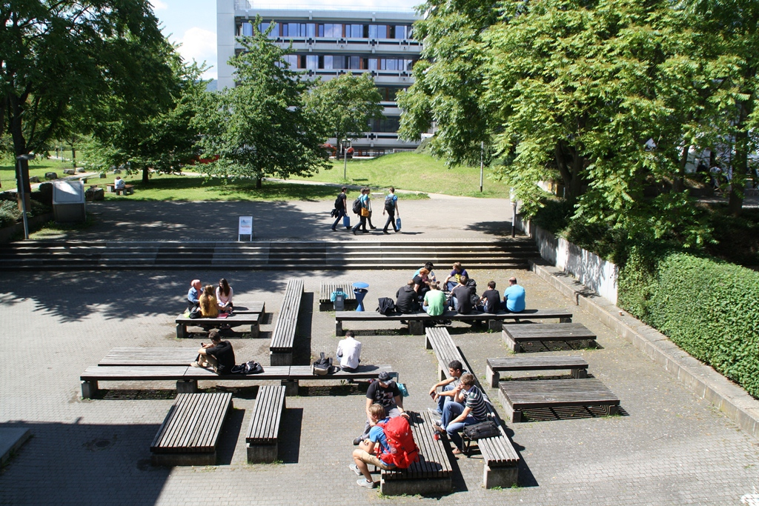
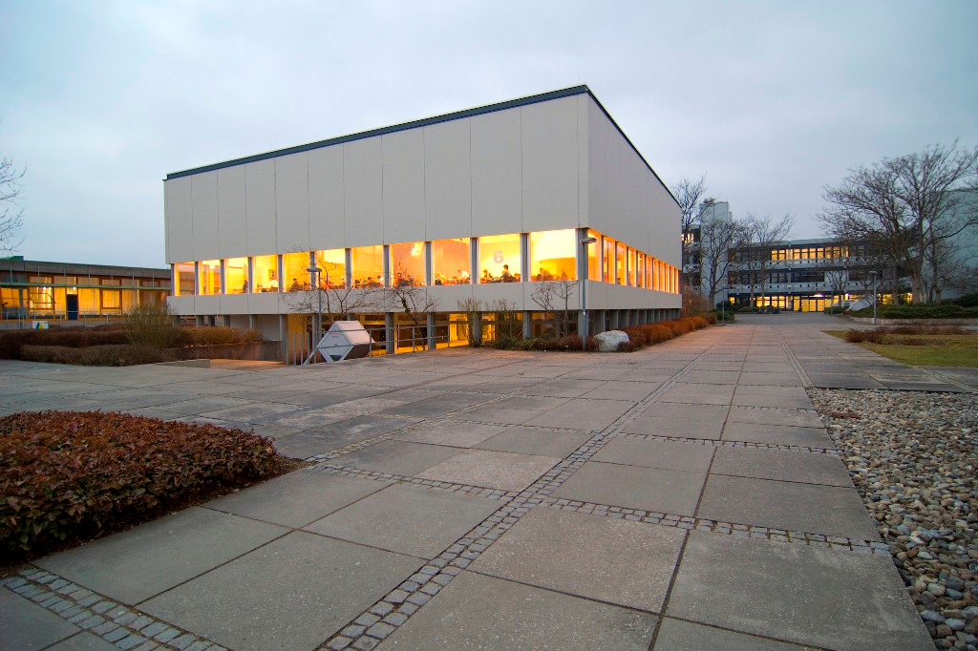
Campus
Our Campus

Slide 6
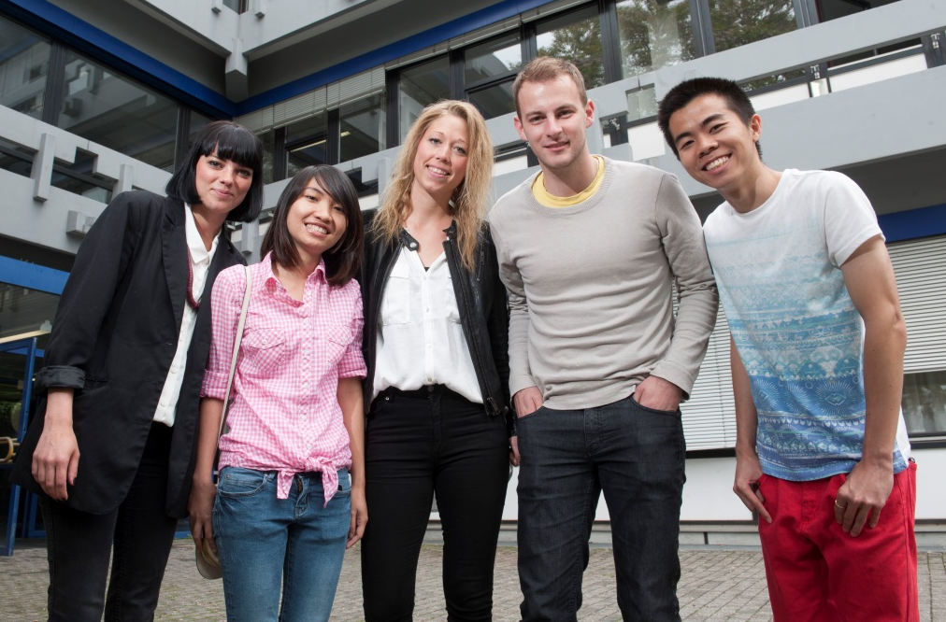
REUTLINGEN university
Reutlingen University stats…
Around 5,200 students and 100 nationalities from over 200 partner universities
In terms of size, international student numbers (20%) and structure, the most international state university in Germany
160 professors from all areas of teaching, research and industry
Approx. 400 guest lecturers from many professional backgrounds and nationalities
Approx. 450 staff, recruited as selectively as the students
5 schools:

Slide 7
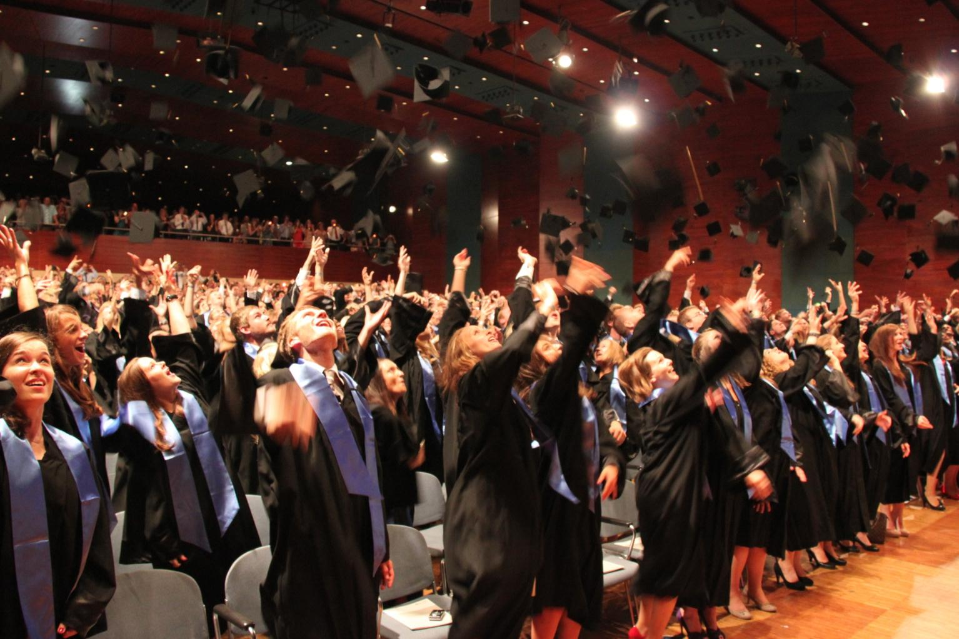
General Facts about ESB Business school
One of the most renowned German business schools
approx. 60 professors
approx. 70 staff
approx. 200 adjunct lecturers
approx. 2,900 students
approx. 30 % at international partner schools or companies,
approx. 30 % international students from 80 nations

Slide 8
General facts about esb Business School
On the road to success: What makes us stand out!
Practical experience
Quality
Internationality
Community

Slide 9
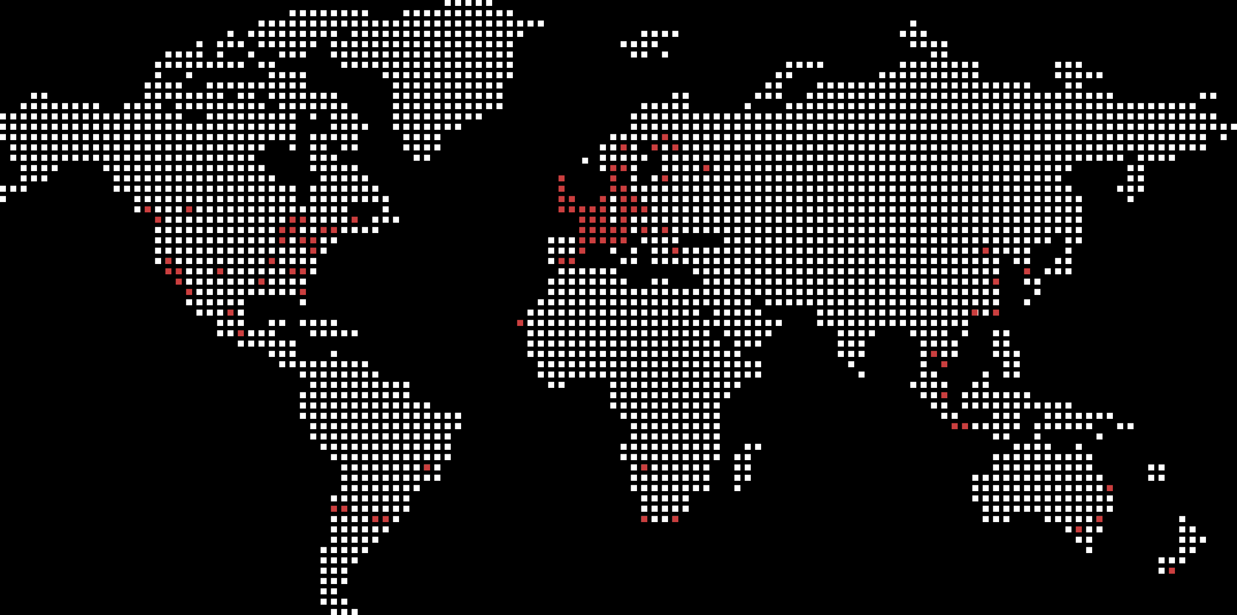
General Facts about ESB Business school
North America:
29
partner universities
Europe:
54
partner universities
Asia:
21
partner universities
Central and Southern America:
7
partner universities
Africa:
3
partner universities
Oceania:
8
partner universities
ESB Business School‘s partner universities
Notes:
dadfadsfasdfasdf

Slide 10
General facts about esb business school
Accreditations
Programme- accredited professional degrees in cooperation with the Knowledge Foundation
ESB Quality Management accreditation according to the German Accreditation Council
ESB as top AACSB accredited business school
National and international accreditations as part of the strategic quality approach of ESB Business School

Slide 11
Welcome – Dorms, Course Selection, Buddies
Why should I study at ESB Business School

Slide 12
degree programmes
ESB Business School‘s programme portfolio
General MBAs
Specialised MBA
MBA FT International Management Full-Time
MBA PT International Management Part-Time
MBA BW International Management for Military Officers and Professionals
MBA
IBD
International Business Development
MGMDC
Global Management and Digital Competencies
MOM
Operations Management
IACT
International Accounting, Controlling and Taxation
EMS
European Management Studies
DIME
Digital Industrial Management and Engineering
Master
Further Education Programmes
CBA
Consulting and Business Analytics
SSM
Strategic Sales Management
IPM
International Purchasing Management
IRM
International Retail Management
IB
International Business
IMX
International Management Double Degree
IWI
International Business Engineering – Operations
SPB Business Engineering – Sustainable Production and Business
Bachelor

Slide 13
Welcome – Dorms, Course Selection, Buddies
Welcome to ESB Business School
Truly international
Taught in English/German
25% of the students on campus are international students
International team of professors
Buddy programme & Welcome Session
brings together new exchange students with regular students
Meet the international team and find support in administrative and academic matters!
Dorms & Activities
Halls of Residence on campus: you need to apply by yourself, but we do offer hints and links to help
Sports, city tour, game nights, other integration events for exchange students organised by buddies
German language courses
Intensive German Language Course before the start of the winter semester
Broad offer of German (and other) language courses during the semester
Lectures and activities offered by Reutlingen International Office (RIO)

Slide 14
Information for international students
Information on Covid-19 situation:
currently we try to offer as many lectures on campus as possible
Access to face-to-face lectures for students who are either vaccinated, recovered or tested (every 24 hours)
exchange students can and should come on campus ☺
hybrid/online way of teaching might still be necessary

Slide 15
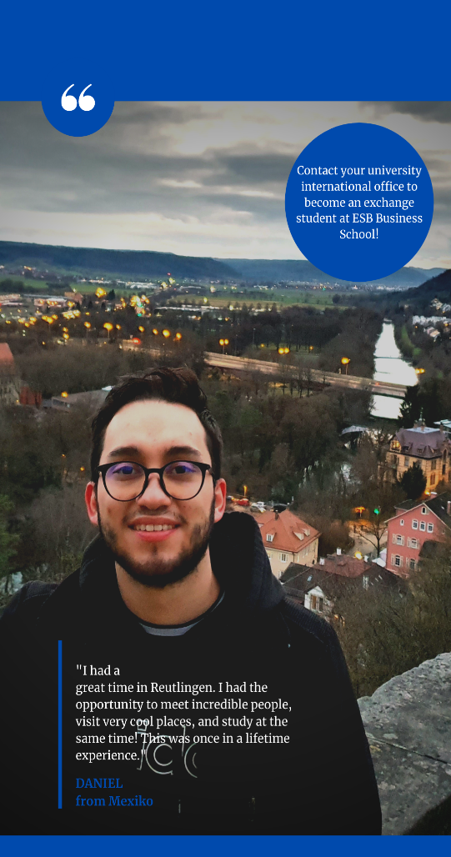
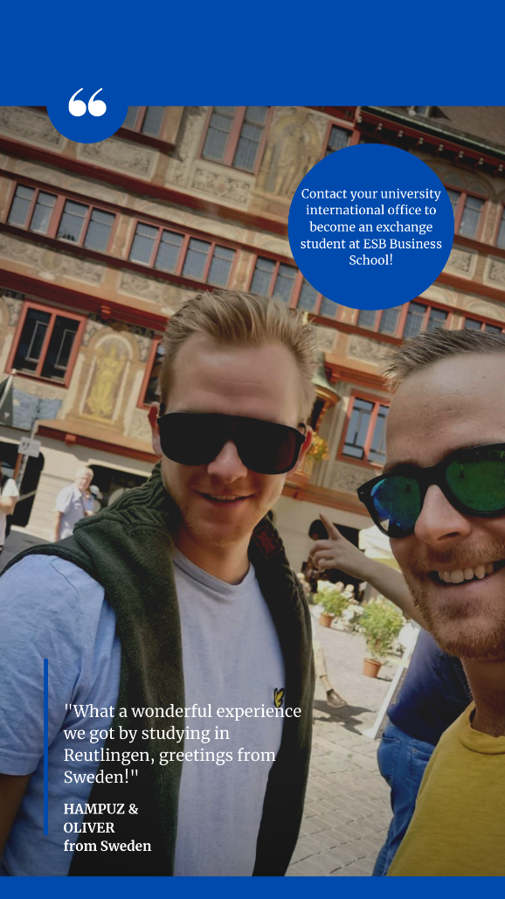
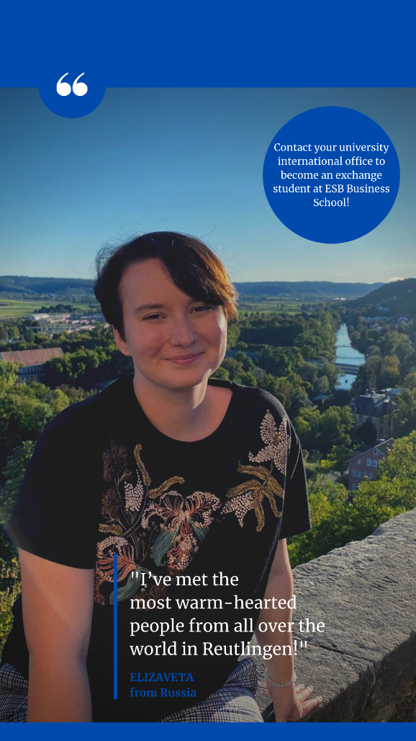
testimonials
Our Exchange students say…

Slide 16
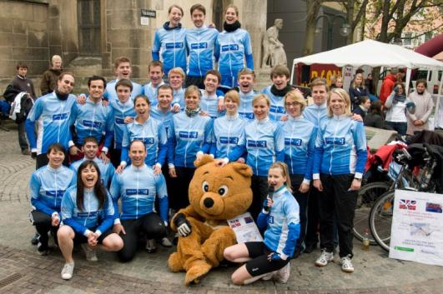
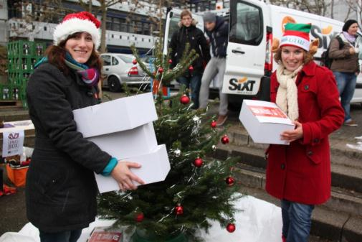
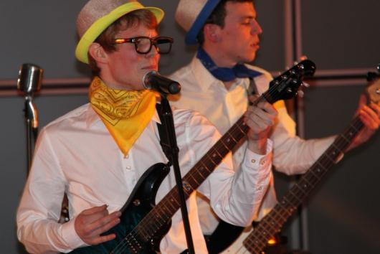
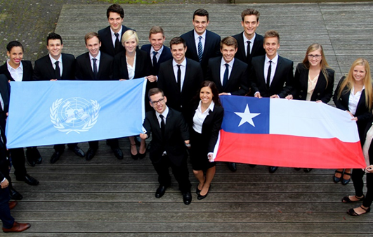
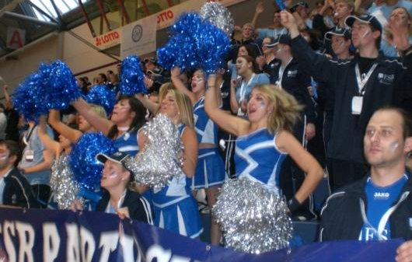
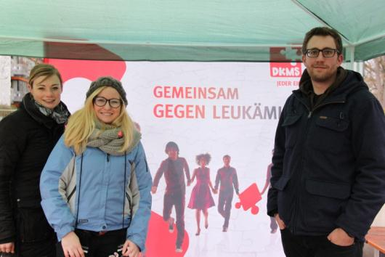
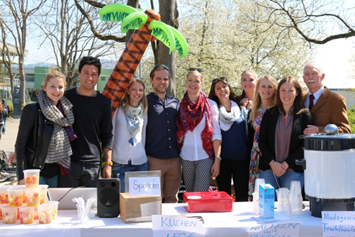
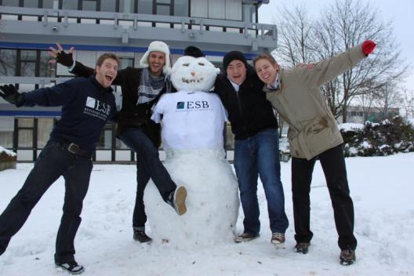
Community – ESB Student Network
Commited students:
ESB Student Network

Slide 17
Company network
Close cooperation with top international companies

Slide 18
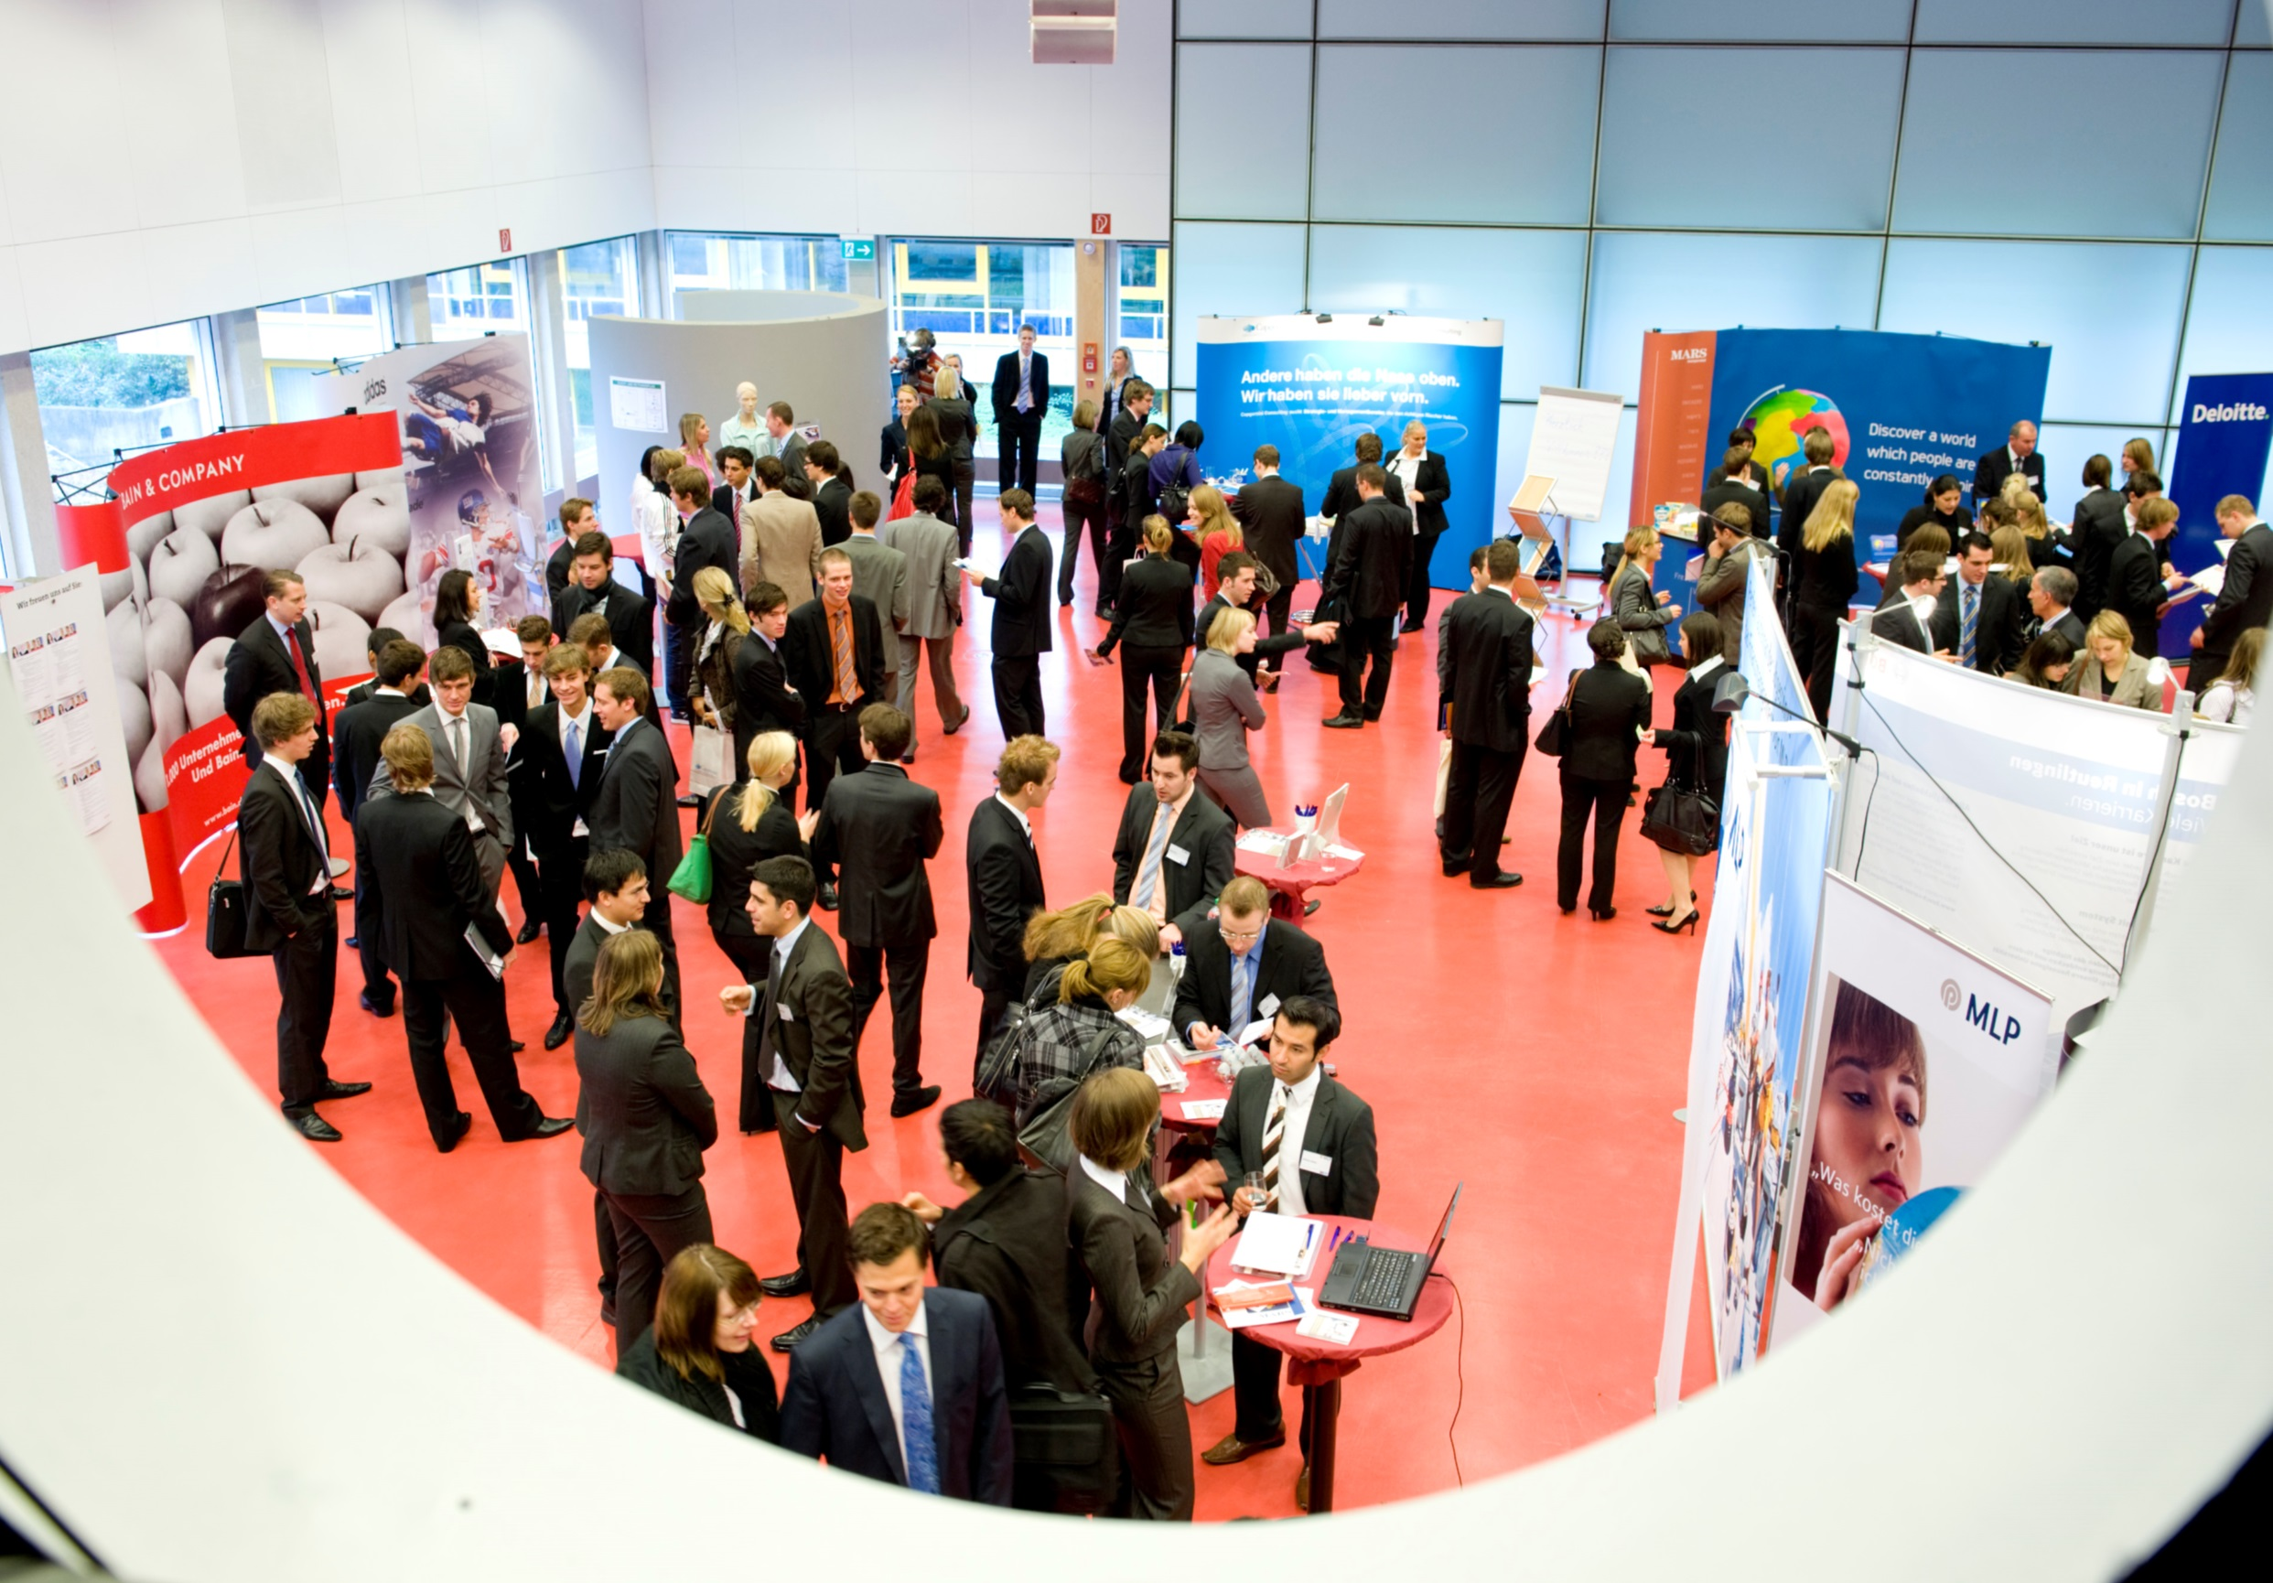
Career Center
Everything you need to plan your career
Company visits
Careers advice
Careers fairs
Workshops + lectures
Online Job Exchange
Electronic catalogue of graduates
Preparation events for careers fairs
CV database

Slide 19
Website and Social Media accounts
Get to know ESB Business School!
Videos:
Official ESB campus Tour
and Why you should study at ESB Business School explained in one minute
Video about ESB
The official song of ESB Business School
Official social media accounts:
Instagram: https://www.instagram.com/esb.business.school/
YouTube: https://www.youtube.com/c/ESBBusinessSchoolRT/
Facebook: https://www.facebook.com/esb.businessschool
Twitter: https://twitter.com/esbreutlingen
LinkedIn: https://www.linkedin.com/school/esb-business-school/

Slide 20
Impressum
Thank you for your interest and hope to seeing you soon on campus!
Hochschule Reutlingen ESB Business School
November 2021
Fotos | Photographs ESB Business School Karl Scheuring

